Slide 1

Online E-commerce
Website

Slide 2


Presented By
Presented To
Name:Tanvir Ahmed Apu
ID: 212 505 1045
Name:Shariful islam sajib
ID: 212 505 1016
Name:Sowrobh Bhuiyan
ID: 212 505 1026
Name
1.Fatema Tuj Tarannom Esty
2.Md. Safaet Hossain
Professor
Dept. of CSE
University of Information Technology and
Sciences

Slide 3







Presentation outline
1 | Introduction
2 | Background Study
3 | Problem statement
4 | Motivations of the research
5 | Objectives
6 | Materials and Methods
7 | Result And Discussion of survey
8 | Limitations
9 | Future Works
10 | Conclusion
11 | Reference

Slide 4





Introduction
Our online e-commerce platform to facilitate the buying and selling of products/services over the internet.
Our project based on Php backend and front end Html,CSS,Js.

Slide 5

Background Study
Ecommerce: The History and Future of Online Shopping (Big Commerce).
E-commerce Development in Bangladesh(Tohidul karim at 2018 )

Slide 6




Problem Statement
Limited accessibility for geographically distant customers
Operational inefficiencies in inventory management, order processing, and customer support
Competitive disadvantage against e-commerce-enabled competitors

Slide 7


Motivation of the research
Capitalize on growth of e-commerce industry and consumer preference for online shopping
Reach wider customer base beyond physical store location
Improve operational efficiency and reduce manual efforts
Gain data-driven insights to enhance strategic decision-making

Slide 8


Objectives
Provide seamless online shopping experience
Automate operations to improve efficiency
Gain data insights to inform decisions
Expand customer reach through e-commerce
Enhance competitive position

Slide 9

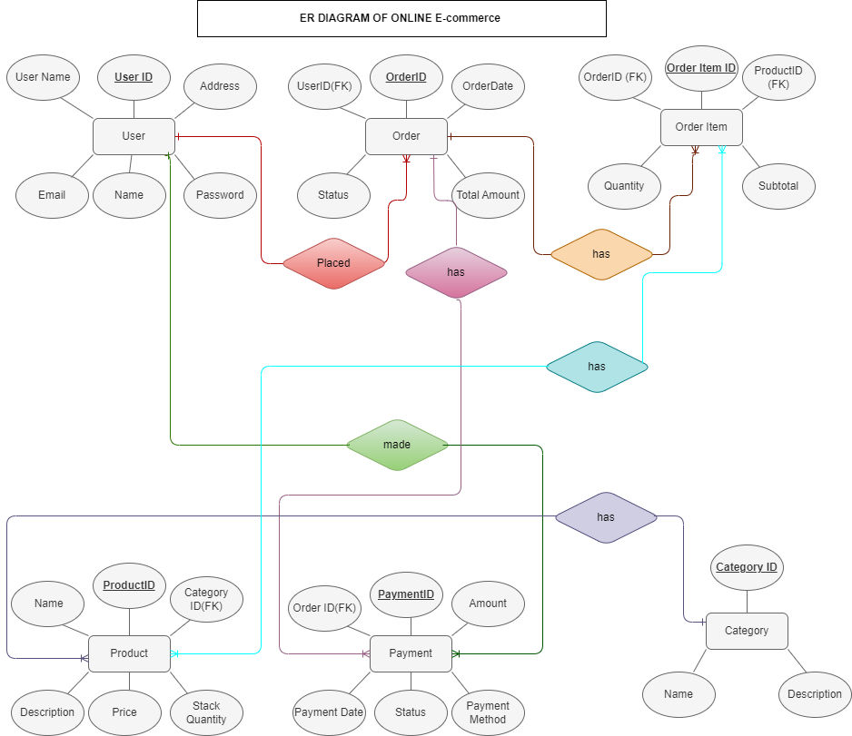
ER-Diagram

Slide 10
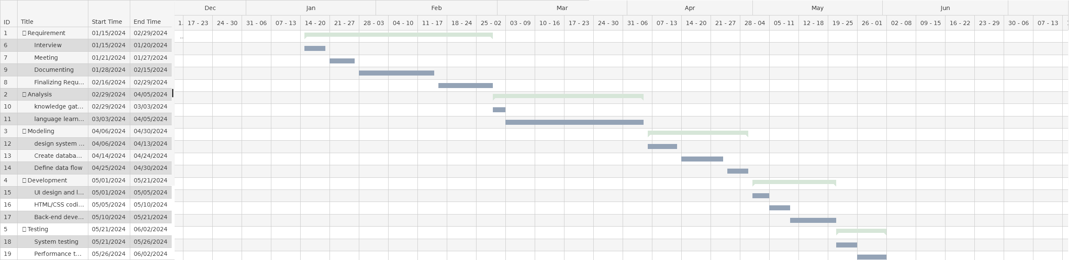
Gantt Chart

Slide 11
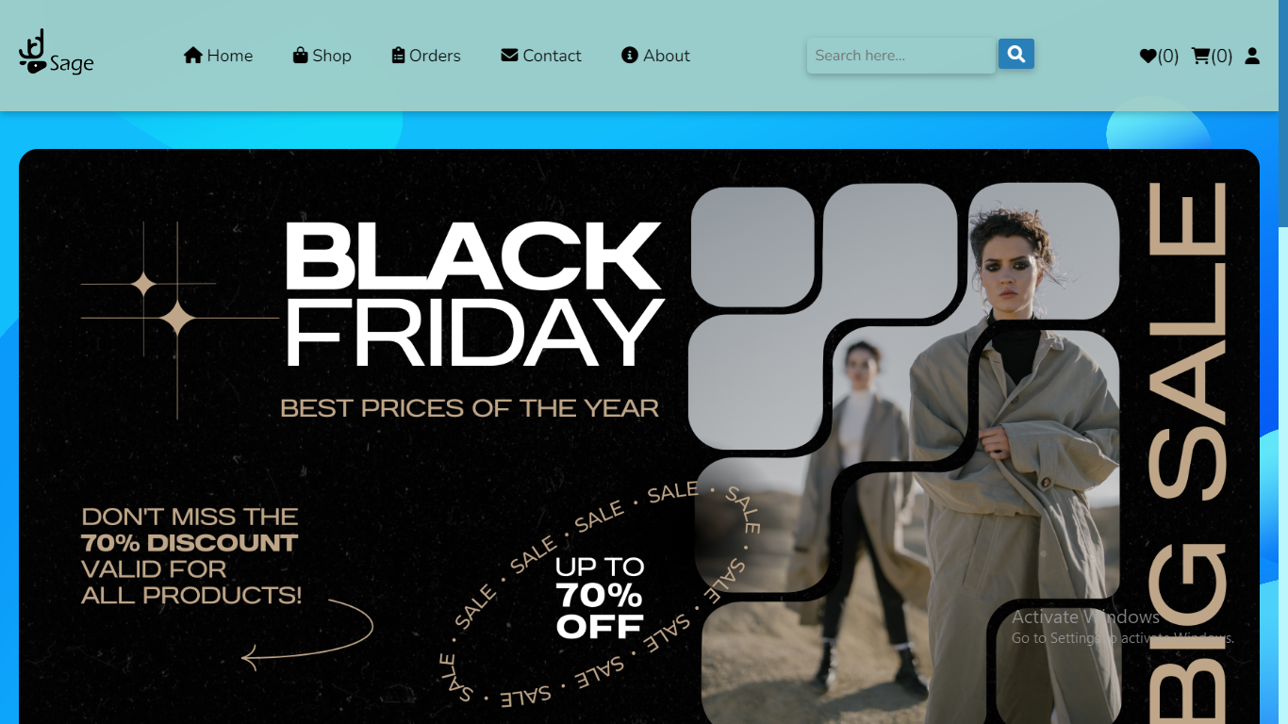
Website

Slide 12





Limitations
Integration with physical store operations
Compliance and regulatory requirements
Scalability and long-term maintenance challenges

Slide 13


Future Works
Implement advanced personalization and recommendation features
Integrate emerging technologies (e.g., AI, AR/VR) to enhance user experience

Slide 14

Conclusion
Critical strategic initiative
Seamless, user-friendly shopping experience
Improved operational efficiency through automation
Valuable data-driven insights

Slide 15
Reference
Amazon
Youtube
Wikipedia
Github
Codepen

Slide 16


Questions and answers

Slide 17
Thank You Everyone

